Slide 1
SimiGrad: Fine-Grained Adaptive Batching for Large Scale Training using Gradient Similarity Measurement
Heyang Qin^{1,2}, Samyam Rajbhandari², Olatunji Ruwase²,
Feng Yan¹, Lei Yang¹, Yuxiong He²
¹University of Nevada, Reno
²Microsoft
Notes:
Logo only not Microsoft word

Slide 2
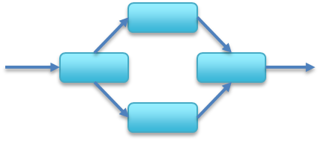
Large Scale Deep Learning
Machine 1
Machine 2
Machine 3
Model Parallelism
Machine 1
Machine 2
Machine 3
Data Parallelism
Fast growing of deep learning model scale
Various parallelism & large batch training are essential
Pipeline Parallelism

Slide 3
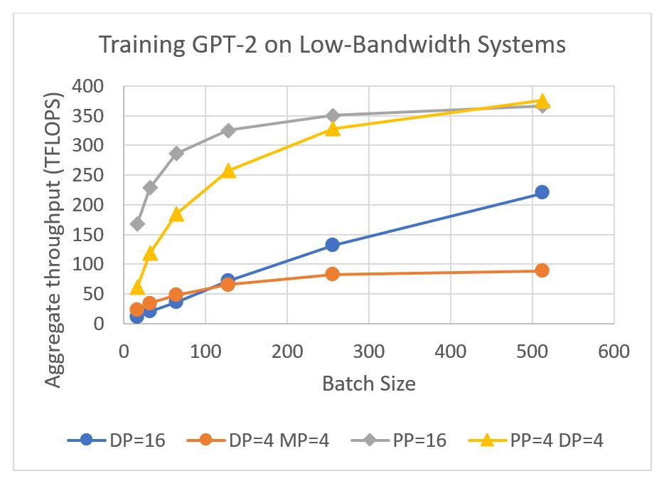
Large Batch Size and Scalability
Large batch size improves scalability and efficiency:
1.
Fewer number of model updates
(reduced communication overhead)
2.
Improved hardware efficiency
(better throughput)
small batch
large batch
Forward and Backward
Model Update

Slide 4
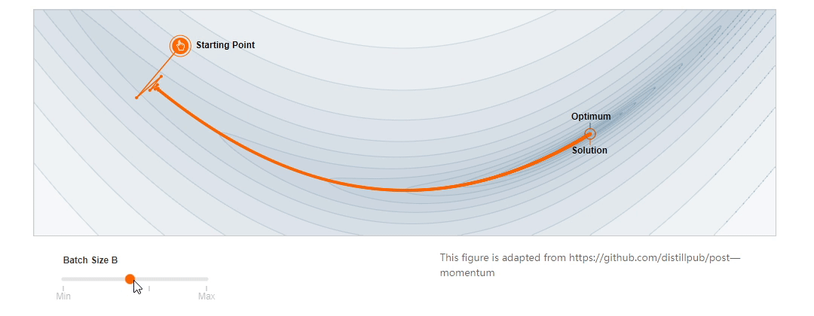
Large Batch Size and Model Performance
Improper large batch size leads to bad model performance
Proper batch size changes during training: need adaptive batching

Slide 5
Large Batch Size Challenges
Large batch size improves scalability and efficiency
Improper large batch size leads to bad model performance
Adaptive batch size is needed during training
Model
Performance
Scalability
Efficiency
How to find a proper batch size adaptively during training?

Slide 6
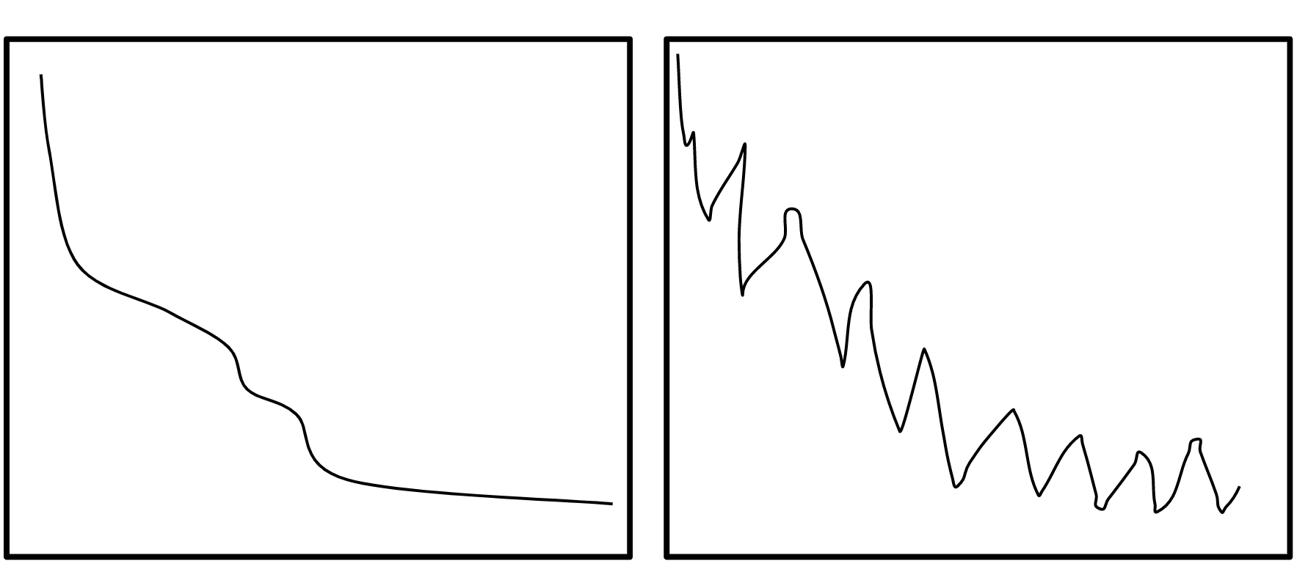
Existing Solutions
Correlation of gradient variance and batch size
Gradient variance based solutions[1][2]:
Batch size and gradient variance are correlated[1][3]
Proper large batch size = maintain proper gradient variance
Ref:
[1] Sam McCandlish, et.al., and OpenAI Dota Team. An empirical model of large-batch training, arXiv 2018
[2] Zhewei Yao, et. al.. Large batch size training of neural networks with adversarial training and second-order information, arXiv 2018
[3] Xin Qian, et.al., The Impact of the Mini-batch Size on the Variance of Gradients in Stochastic Gradient Descent , arXiv 2020
Training Error
Iterations
Iterations
Appropriate gradient variance level
Undesired gradient variance level
Images from WISC CS760 and [3]

Slide 7
Existing Solutions
Estimation of gradient variance
Ref:
[1] Sam McCandlish, et.al., and OpenAI Dota Team. An empirical model of large-batch training, arXiv 2018
[2] Tyler B. Johnson, et.al.,
AdaScale SGD: A User-Friendly Algorithm for Distributed Training. ICML 2020
Others
Ref:
[3] Samuel L. Smith, et.al,
Don't Decay the Learning Rate, Increase the Batch Size. ICLR 2018
Expensive computation of gradient variance
Reduce measuring frequency
Cheap approximation of gradient variance
Coarse-grained adjustment
Bad choice of batch size
Noisy estimation

Slide 8
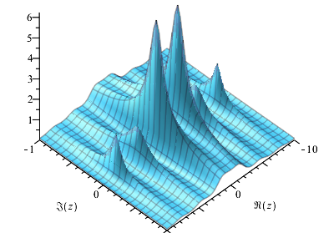
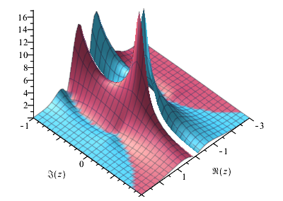
Key Idea
A full batch
Goal: measure gradient variance accurately with little overhead
Key observation: global batch is divided into smaller micro batches, whose gradients are already available
Idea: see a single batch as two half batches and measure similarity between their gradients
seen as
A half batch
A half batch
Gradients
Gradients
Similarity
(gradient variance estimation)

Slide 9
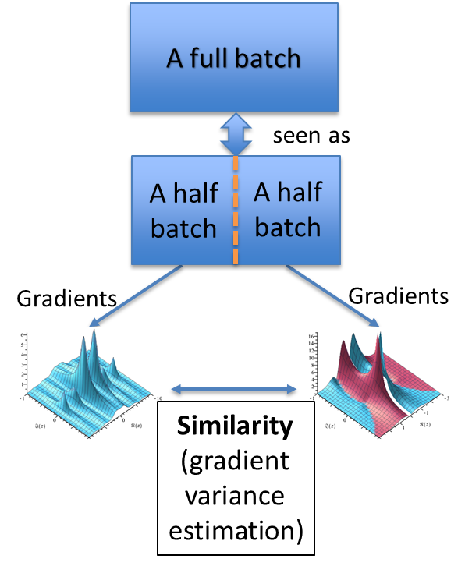
SimiGrad Measurement
Benefits:
Minimal overhead

Slide 10
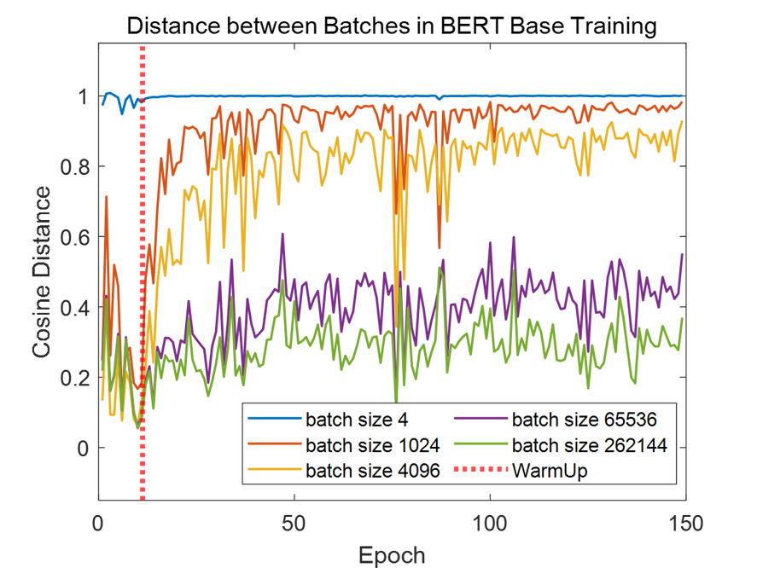
SimiGrad Measurement
Benefits:
Minimal overhead
Normalized and bounded

Slide 11
SimiGrad Measurement
Benefits:
Minimal overhead
Normalized and bounded
Closely related to gradient variance

Slide 12
SimiGrad
SimiGrad adjusts batch size and learning rate together by keeping similarity measurement at a reasonable level
Learning rate scaling[1]:
$$\frac{Learning rate_old}{Learning rate_new}=\sqrt{\frac{Batch size_old}{Batch size_new}}$$
Ref:
[1] Alex Krizhevsky. One weird trick for parallelizing convolutional neural networks. arXiv 2014.
Get similarity measurement
Compare with
similarity target
Smaller than target
Larger than target
Increase batch size
Decrease batch size
Update learning rate

Slide 13
SimiGrad Implementation
How SimiGrad works in actual machine learning system?
Replica 0
$$G_{0}$$
Replica 1
$$G_{1}$$
Replica 2
$$G_{2}$$
Replica 3
$$G_{3}$$
Group 1
Group 2

Slide 14
SimiGrad Implementation
How SimiGrad works in actual machine learning system?
Replica 0
$$G_{0}$$
Replica 1
$$G_{1}$$
Replica 0
$$\overline{G_{0}+G_{2}}$$
Replica 1
$$\overline{G_{1}+G_{3}}$$
AllReduce
Replica 2
$$G_{2}$$
Replica 3
$$G_{3}$$
Replica 2
$$\overline{G_{0}+G_{2}}$$
Replica 3
$$\overline{G_{1}+G_{3}}$$
Group 1
Group 2
Group 1
Group 2
Compute similarity
$$Sim=Cos(\overline{G_{0}+G_{2}},\overline{G_{1}+G_{3}})$$
The gradient information is already there
thus SimiGrad has minimal overhead

Slide 15
SimiGrad Implementation
How SimiGrad works in actual machine learning system?
Replica 0
$$G_{0}$$
Replica 1
$$G_{1}$$
Replica 0
$$\overline{G_{0}+G_{2}}$$
Replica 1
$$\overline{G_{1}+G_{3}}$$
Replica 0
$$G$$
Replica 1
$$G$$
AllReduce
AllReduce
Replica 2
$$G_{2}$$
Replica 3
$$G_{3}$$
Replica 2
$$\overline{G_{0}+G_{2}}$$
Replica 3
$$\overline{G_{1}+G_{3}}$$
Replica 2
$$G$$
Replica 3
$$G$$
$$G=\overline{G_{0}+G_{1}+G_{2}+G_{3}}$$
Group 1
Group 2
Group 1
Group 2
Compute similarity
$$Sim=Cos(\overline{G_{0}+G_{2}},\overline{G_{1}+G_{3}})$$
The gradient information is already there
thus SimiGrad has minimal overhead

Slide 16
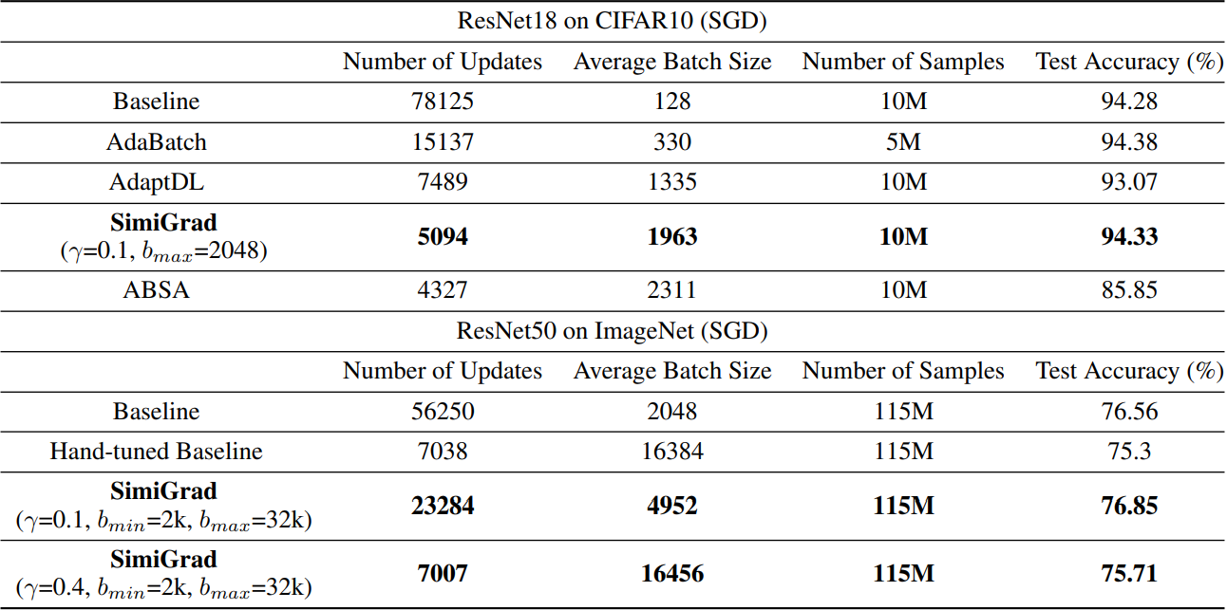
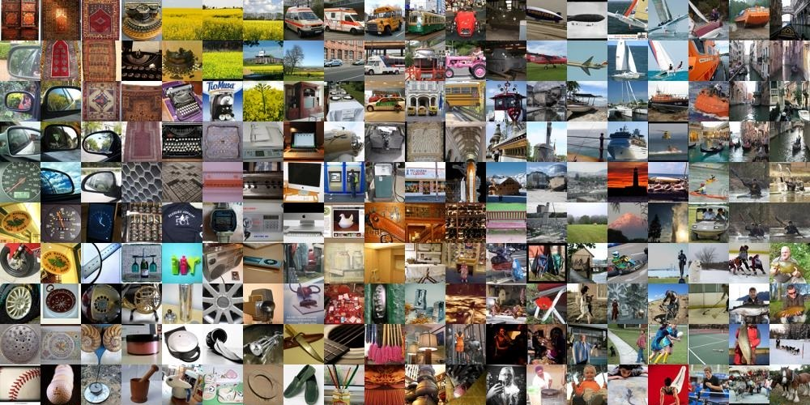
Evaluation - Performance
SimiGrad is implemented on DeepSpeed
Vision
SimiGrad achieves SOTA performance while:
With 3x larger batch size on CIFAR10
With 2x larger batch size on ImageNet

Slide 17
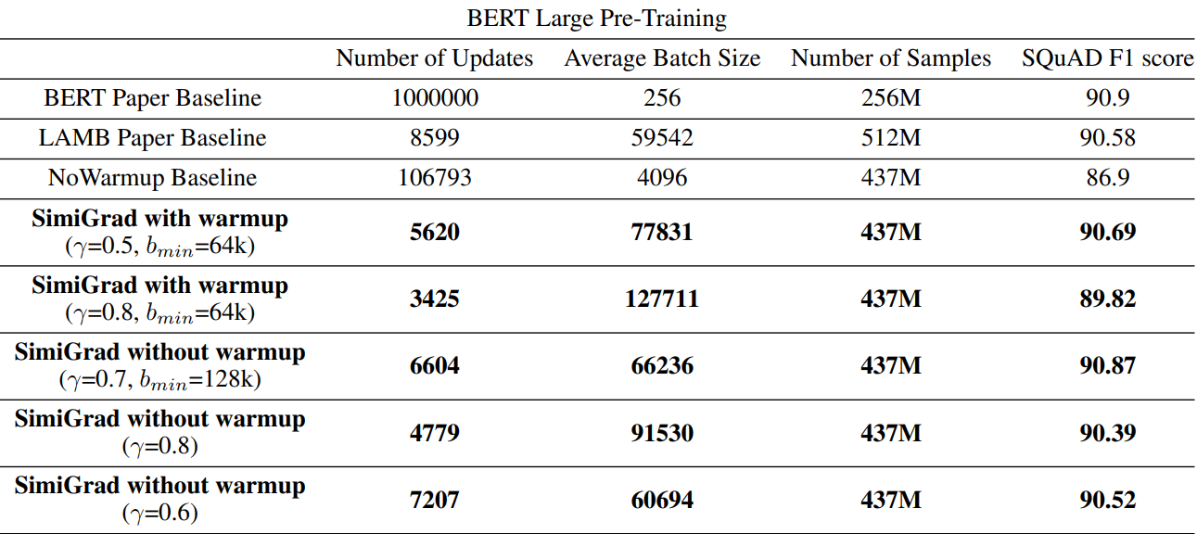
Evaluation - Performance
SimiGrad is implemented on DeepSpeed
Natural Language
SimiGrad achieves SOTA performance while:
With 1.3x larger batch size on BERT-Large (a new record)

Slide 18
Evaluation - Pareto
(a) ResNet18 on CIFAR10
(b) ResNet50 on ImageNet
(c) BERT Large Pretrain
SimiGrad linear lr
linear lr warmup sqrt lr
sqrt lr warmup
90.8
sota SimiGrad
90
75.0
72.5
SQuAD 1.1 Score
90.6
80
Test Acc.
Test Acc.
70.0
90.4
70
67.5
90.2
60
65.0
sota SimiGrad
4k8k 16k 32k
90.0
50
62.5
60.0
89.8
1k 4k 8k 16k
Average Batch Size
32k
48k
60k
80k 100k 120k
Average Batch Size
Average Batch Size
SimiGrad has better Pareto efficiency than baseline and SOTA:
With the same batch size, SimiGrad has better performance
With the same performance, SimiGrad has larger batch size

Slide 19
Evaluation - Robustness
SimiGrad can automatically warmup learning rate (w/o hand-tuned scheduler)
SimiGrad works well under different hyperparameters

Slide 20
Takeaway
Take a step back and look at what we have
Existing gradient can be utilized to calculate variance
Similarity measurement is simple but effective

Slide 21
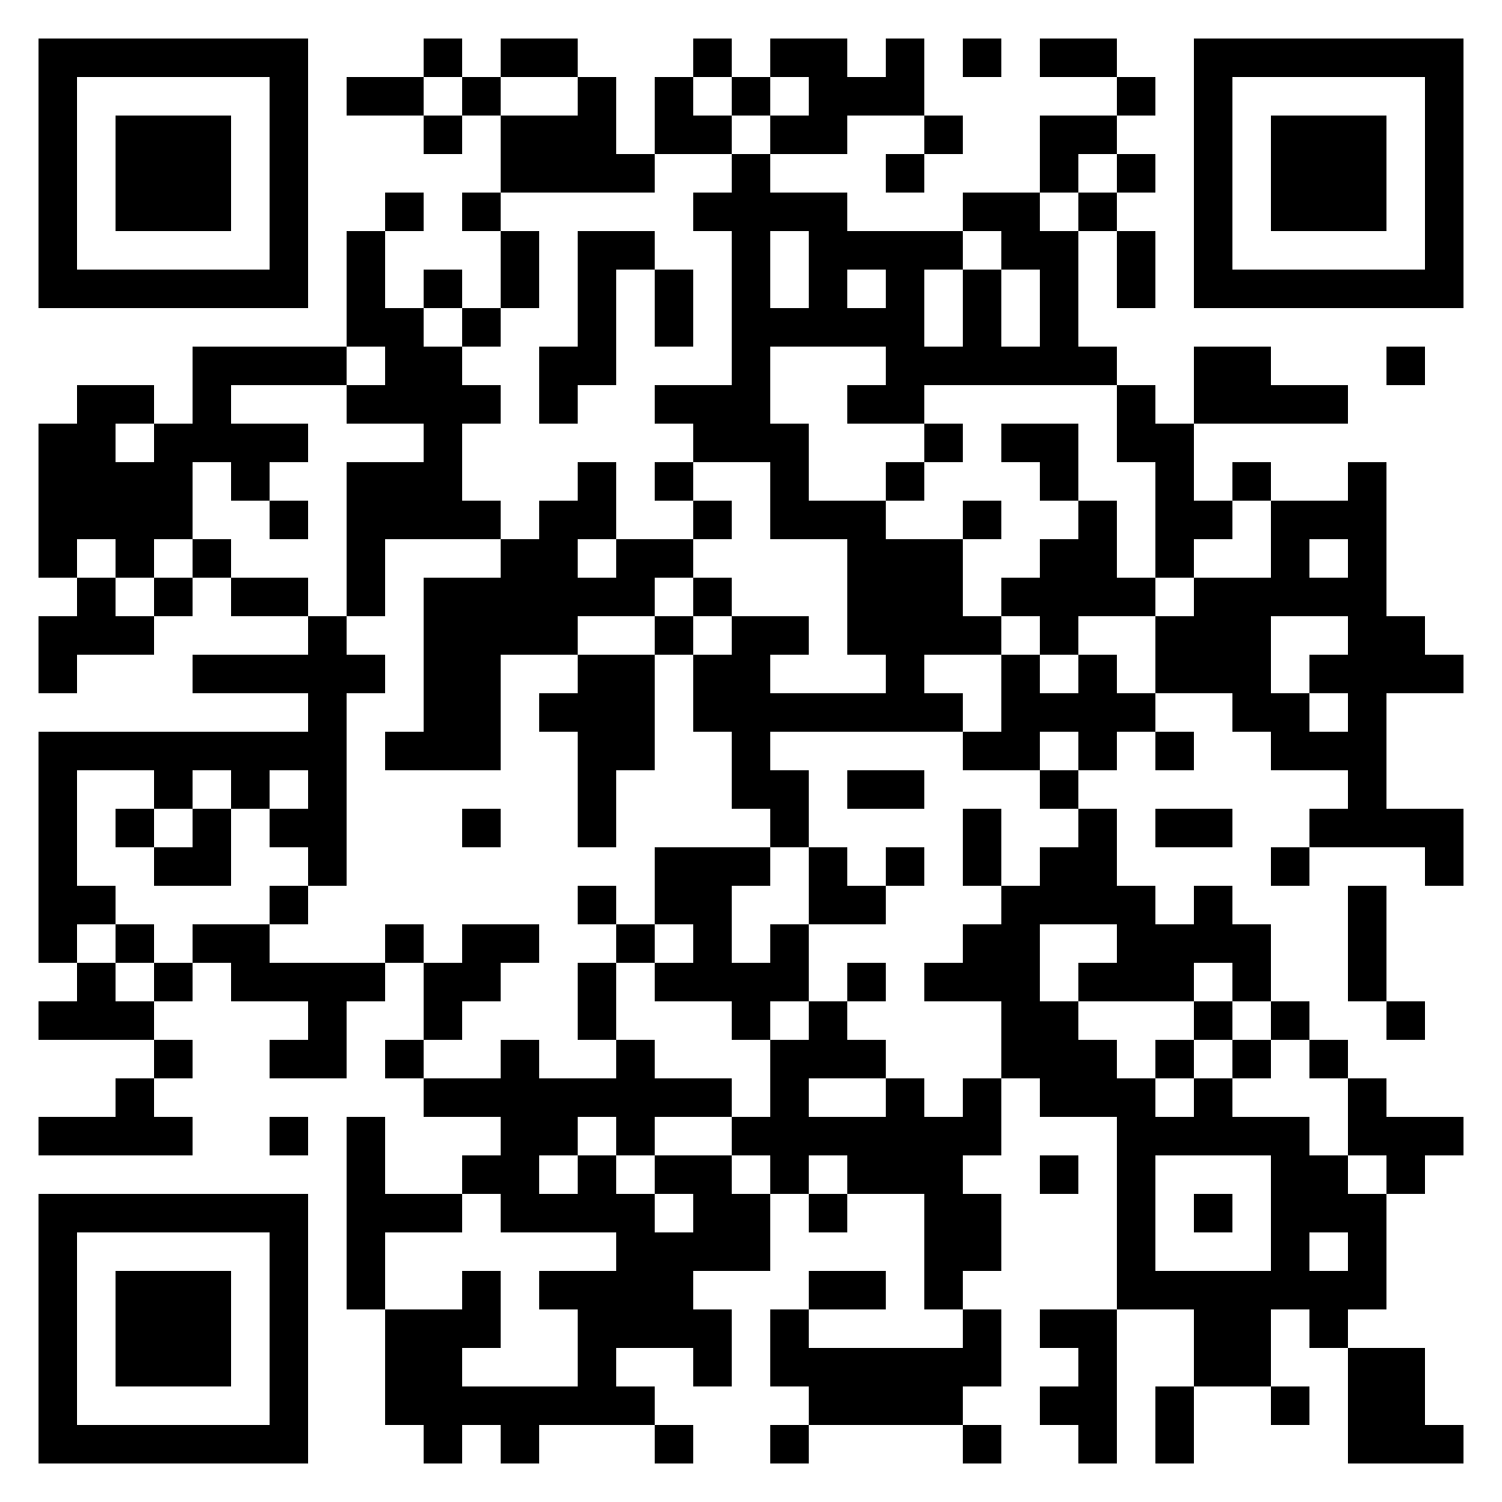
This work is supported by
University of Nevada, Reno, Microsoft Research, National Science Foundation
Thank you!
SimiGrad will be officially integrated as part of DeepSpeed framework soon, stay tuned!
Code: https://github.com/HeyangQin/SimiGrad
Questions?
heyang_qin@nevada.unr.edu,
https://www.cse.unr.edu/~heyangq/

Slide 23
Parallelize Deep Learning
Machine 1
Machine 2
Machine 3
Machine 1
Machine 2
Machine 3
Model Parallelism
Data Parallelism
Pipeline Parallelism
Batch size is a key control knob of parallelism
Notes:
Redo text. Slides 2 and 3 could be merged

Slide 24
Challenge of Batch Size
small batch
large batch
Model
Performance
Scalability
Efficiency
Model Update
Forward and Backward
How to achieve desired scalability and efficiency without harm model performance?

Slide 25
Existing Solutions
Coarse-grained Adjustment
Non-trivial
Overhead
Limited
Scalability
Strong Assumptions on Learning Rate
Notes:
List the papers here ,noise, and overhead, we can do both. Use more abstract way to say: for example, we use existing gradient information, no extra computation at all

Slide 26
Key Idea
See a single batch as two half batches and measure cosine similarity between their gradients
A full batch
A half batch
A half batch
A half batch
A half batch
Cosine Similarity
Minimal Overhead
Fine Granularity
Closely Related to Gradient Variance
(with Math Proofs)
Normalized and Bounded
Smile Face Icon from Creative Stall

Slide 27
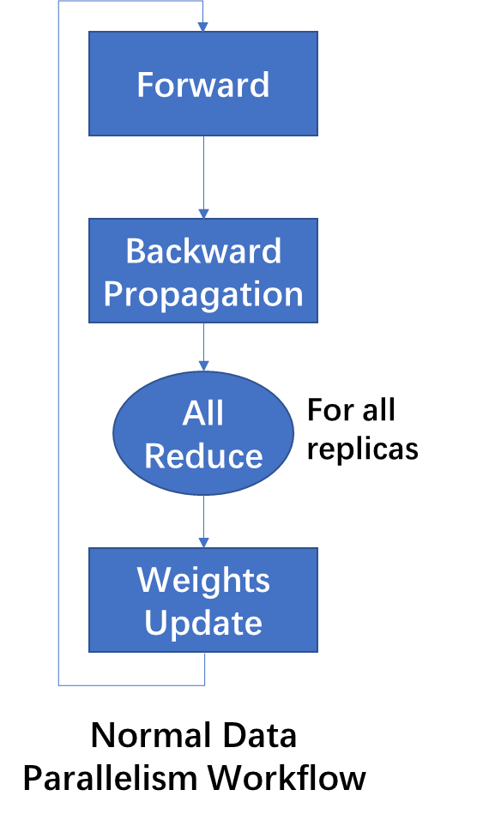
SimiGrad
SimiGrad utilize the gradients from different replicas
Replica 0
Replica 1
Replica 0
Replica 1
AllReduce
Replica 2
Replica 3
Replica 2
Replica 3

Slide 28
Key Idea
A full batch
Total gradient variance
Cosine similarity between two half batches
See as
A half batch
A half batch
Benefits:
Minimal Overhead
Normalized and Bounded
Closely Related to Gradient Variance
Gradients
Gradients
Cosine Similarity

